Slide 1
Step 1:
https://github.com/wake-forest-ctsi/CALIBIR-boot-camp/tree/main
Or google “wake forest ctsi github”, go to the CTSI github page, and then go to CALIBIR bootcamp

Slide 2
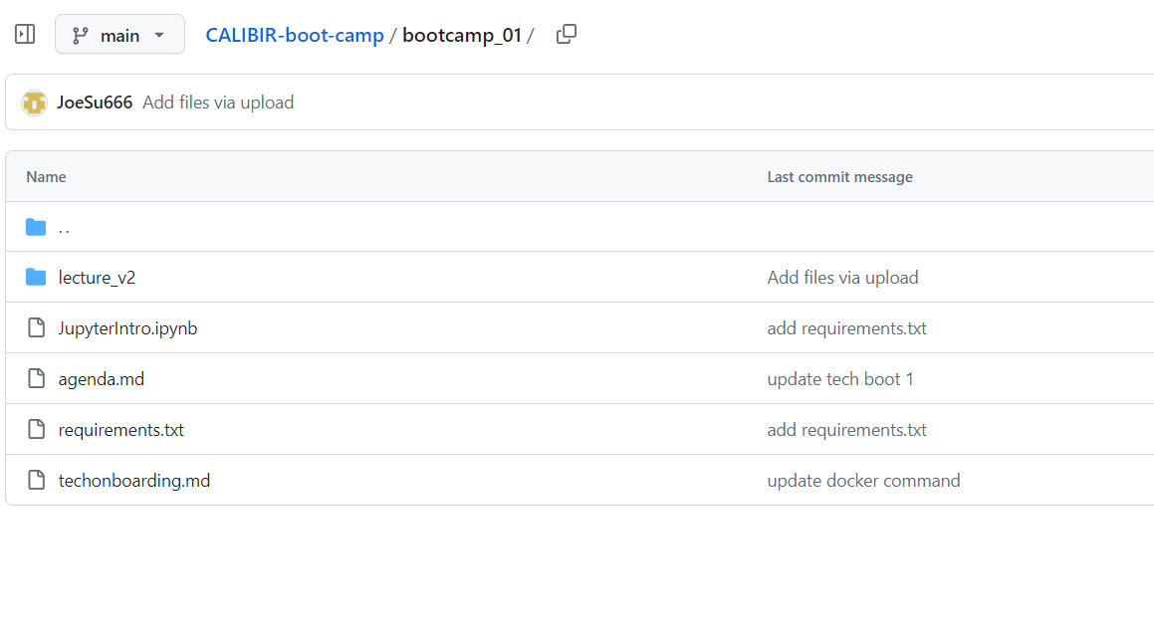
Step 2
Select “bootcamp_01”, then “lecture_v2”

Slide 3
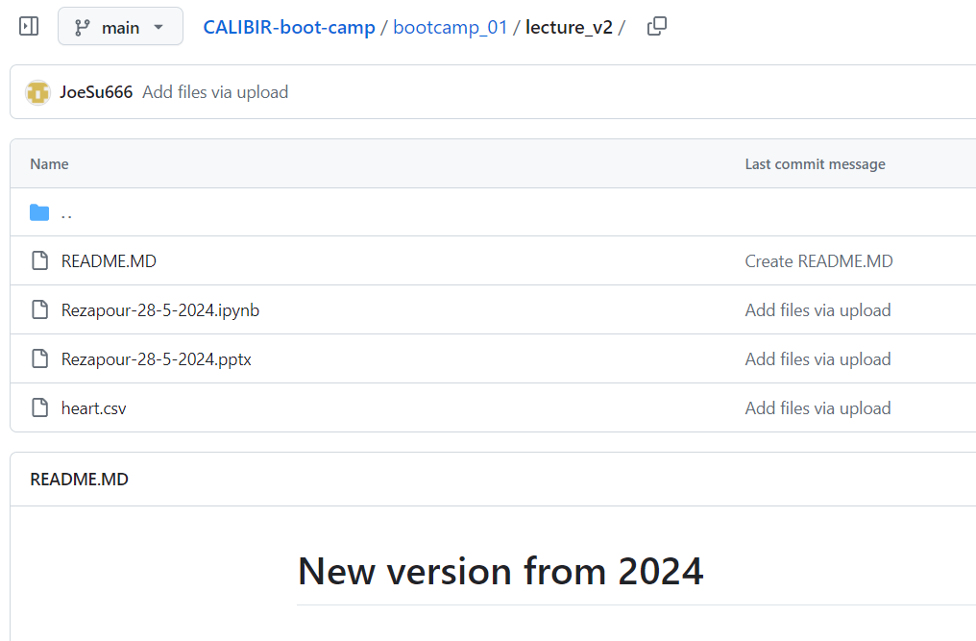
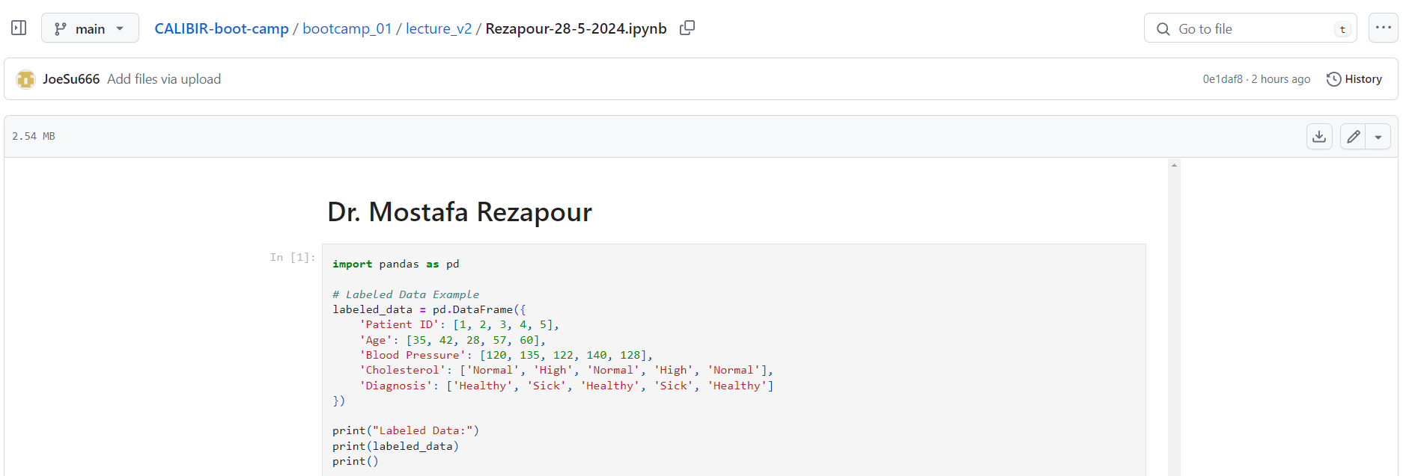
Step 3
Download everything into a local folder in your computer

Slide 4
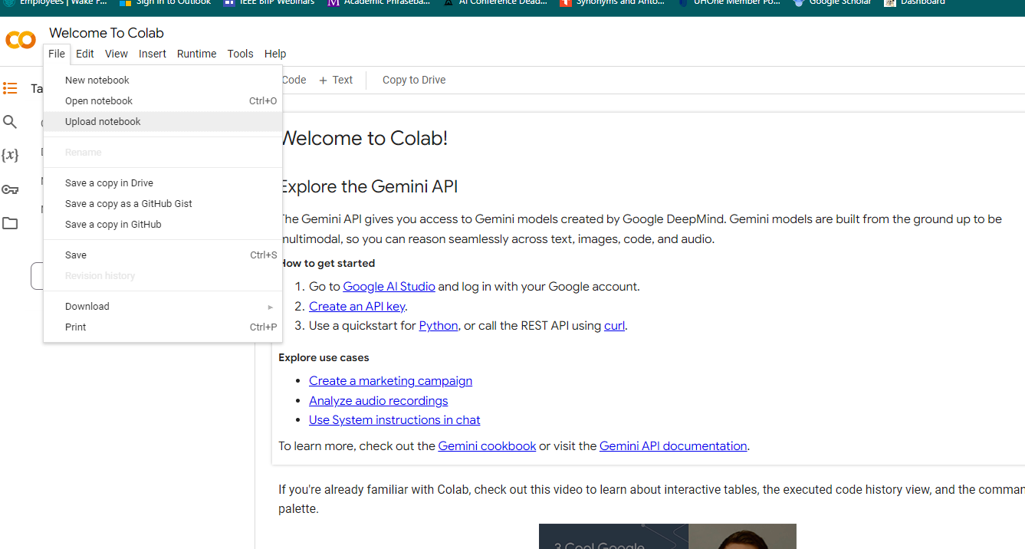
Step 4
Open Colab in your browser
Load the .ipynb file into the Colab

Slide 5
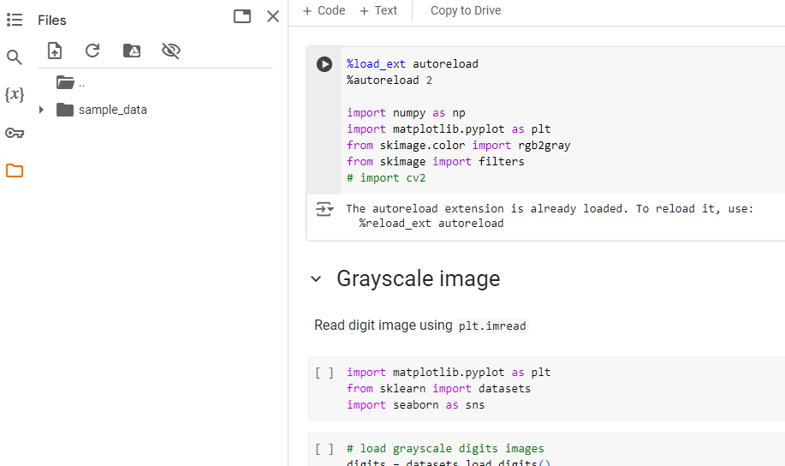
Step 5
Upload your data (heart.csv) in here. This will be your working folder on the cloud

